Slide 1
RMI

Slide 2
Distributed Systems
Consider a complex system, consisting of many communicating components
  the components are physically distributed among several hosts
  each component has its special functionality and requirements
  the components may be executing on different platforms

Slide 3



Distributed Systems
maps db
traffic information
traffic analysis
& planning
video processing
traffic statistics
traffic-lights
control
video cameras
at junctions
Real-life systems might be more complicated

Slide 4
Distributed Systems
In client-server model
  protocol for every pair of communicating entities
  complex protocol that would suit all
Defining a protocol includes:
  the format in which the data is transferred
  the possible requests/replies at each state
  error handing
We would like to devise a simpler model

Slide 5
Distributed Applications
Distributed application consists of a set of communicating components
Unlike in a regular application, the components are distributed among several machines
The location of an object in memory is unknown
  Why should we care for the location of the host in which the object is found?
  Why can not we just refer to an object found on a remote machine by using a reference?

Slide 6
Remote References
Suppose we could refer to a remote object using a references
  We could invoke methods on the remote reference that would execute on the remote host
  We could transfer information to/from remote objects as method parameters and returned values
The protocols would be reduced to a set of method calls between the components
The application would look as a regular (non distributed) one.

Slide 7
Remote References
Simple idea: objects existing on one machine may be accessed from another machine through a regular method call.
Eliminates the need to encode and decode data sent over sockets
In other words, the underlying socket code still exists, but it is hidden from the user and the communication is transparent.

Slide 8
Remote References - Summary
In order to use a remote reference, the client
  must know its behavior (interface),
  but does not need to know its implementation (class)
In order to provide an object, the server
  must know both its interface (behavior) and its class (implementation)
Thus, to implement this paradigm
  the interface must be available to both client and server
  the class should only be on the server

Slide 9
Distributed Object Picture
Local code in the local machine holds a remote reference to an object on a remote machine:
res = obj.meth(arg) ;
obj
ResType meth(ArgType arg) {
. . . Any code …
return new ResImpl(. . .) ;
}
Local Machine
Remote Machine

Slide 10
Distributed Object Communication
To send a message to a remote server object,
  The client object has to find the object
    Do this by looking it up in a registry
  The client object then has to marshal the parameters (prepare them for transmission)
  The server object has to unmarshal them, do the computation, and marshal the response
  The client object has to unmarshal the response
Only Serializable objects can be marshaled

Slide 11
Distributed Computing Architecture
Distributed Computing Architecture - architecture that allows to refer to remote objects (software elements executing on remote machines)
Java supports CORBA and RMI distributed architectures
  CORBA is more flexible, platform- and language- independent architecture
    In Microsoft technologies: CORBA→COM→.NET
  RMI is purely Java-specific
    Java to Java communications only
    As a result, RMI is much simpler than CORBA
    Provides a natural semantics for remote methods calls

Slide 12
Remote Method Invocation – RMI
First introduced into JDK 1.1
Java-specific protocol aimed at simplicity
  Java is already platform independent
Closely linked to the idea of client/server
  A server application provides some form of service to zero or more clients
  A client program uses the service
  A Java interface defines the contract between the two

Slide 13
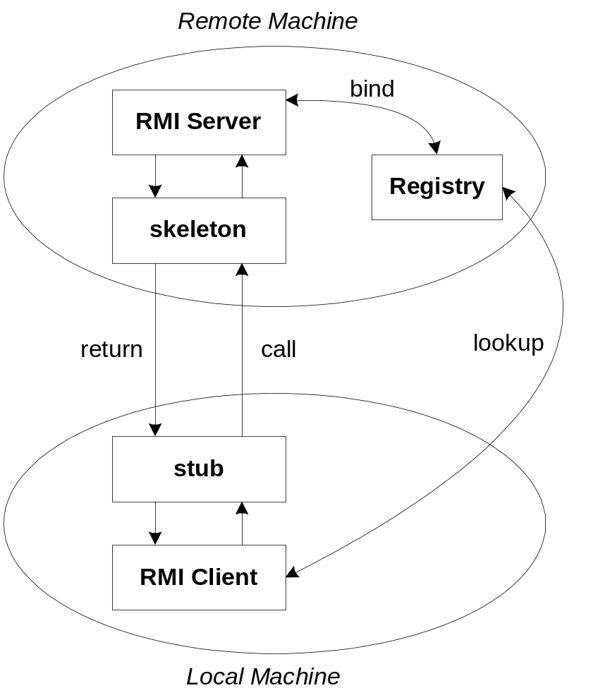
The General RMI Architecture
The server must first bind its name to the registry
The client lookup the server name in the registry to establish remote references.
The Stub serializing the parameters to skeleton, the skeleton invoking the remote method and serializing the result back to the stub.

Slide 14
Remote Method Invocation – RMI
RMI
JDBC
CORBA
java.net
TCP/IP
Network OS

Slide 15
RMI Terminology
A remote object is an object on another computer
The client object is the object making the request
The server object is the object receiving the request
Usually, client and server can change roles (each can request the other)
The rmiregistry is a special server that looks up objects by name
  The name should be unique
rmic is a special compiler for creating stub (client) and skeleton (server) classes

Slide 16
RMI Processes
For RMI, 3 processes should be running
  The Client
  The Server
  The Object Registry (rmiregistry), which functions like a DNS service for objects
TCP/IP protocol active

Slide 17
RMI Registry
Once the server is started it advertises the provided services using a service label
The label is registered with a object registry (rmiregistry) which runs as a daemon
Clients connect to the object registry and ask for the service label they require
  Clients must know where the object registry is located
Clients obtain a reference to their chosen interface and can then call its methods

Slide 18
RMI Registry
Directory that associates names to remote objects through binding
Remote
Object
A
Naming
“X”
Remote
Object
C
“Y”
Remote
Object
B
“Z”
server host

Slide 19
RMI Registry
Client use the registry to find a particular Server object (lookup)
Naming
Object
Client
“X”
Remote
Object
Server
lookup(“Y”)
“Y”
Remote ref.
to Server
“Z”
client host
server host

Slide 20
RMI Architecture
Client Virtual Machine
Server Virtual Machine
1. Server creates Remote Object
2. Server registers Remote Object
3. Server creates the Skeleton
Client
Remote Object
4. Client requests object from Registry
5. Registry returns Remote Reference
(and the Stub gets created)
6
8
1
7
Skeleton
Stub
Server
4
3
5
6. Client invokes the Stub method
7. Stub talks to the Skeleton
8. Skeleton invokes remote object
method
2
“id”
Registry Virtual Machine

Slide 21
General RMI Example
Local Machine (Client)
SampleServer remoteObject;
int s;
…
s = remoteObject.sum(1,2);
System.out.println(s);
Remote Machine (Server)
public int sum(int a,int b) {
return a + b;
}
1,2
3

Slide 22
Java RMI Package
java.rmi
  used by client side
java.rmi.server
  used by server side
java.rmi.registry
  Used to locate, register and name remote object.

Slide 23
Steps for Developing an RMI System
Define the remote interface
Develop the remote object by implementing the remote interface.
Develop the client program.
Compile the Java source files.
Generate the client stubs and server skeletons.
Start the RMI registry.
Start the application

Slide 24
1. Remote Interface
We first define the interfaces for the remote objects
  In CORBA and DCOM, the interfaces are defined using an IDL (Interface Definition Language)
  In RMI, regular Java interfaces are used
In order to declare that the interface is of a remote object for RMI, the interface extends (maybe indirectly) the interface java.rmi.Remote
The java.rmi.Remote interface does not contain any methods or variables

Slide 25
1. Remote Interface
Remote interface serves as an agreement between the client and server.
/* SampleServer.java */
import java.rmi.*;
public interface SampleServer extends Remote
{
public int sum(int a,int b) throws RemoteException;
}

Slide 26
2. Remote Object
Class implementing a remote object,
  extends UnicastRemoteObject class
  implements the above Remote Interface
The methods are implemented in a regular way
Contains a main method that
  creates an instance of the remote object
  registers it at the rmiregistry

Slide 27
2. Remote Object
Remote objects implement one (or more) remote interfaces.
  Specify the remote interface(s) being implemented
Define the constructor for the remote object
Implement the methods to be invoked remotely
Create and install a security manager
Create one (or more) instances of a remote object
Register the remote object with the RMI remote object registry

Slide 28
2. Remote Object
/* SampleServerImpl.java */
import java.rmi.*;
import java.rmi.server.*;
import java.rmi.registry.*;
public class SampleServerImpl extends UnicastRemoteObject implements SampleServer
{
SampleServerImpl() throws RemoteException
{
super();
}
public int sum( int a, int b) throws RemoteException
{
return a + b;
}

Slide 29
2. Remote Object
public static void main(String args[])
{
try
{
//create a local instance of the object
SampleServerImpl server = new SampleServerImpl();
//put the local instance in the registry
Naming.rebind("SAMPLE-SERVER" , server);
System.out.println("Server waiting.....");
}
catch (java.net.MalformedURLException me)
{re.printStackTrace();}
catch (RemoteException re) {re.printStackTrace();}
}
}

Slide 30
2. Remote Object
The remote object is named SAMPLE-SERVER
It is bound to rmiregistry using Naming.bind() or Naming.rebind() methods
The Naming class is used to communicate with the local registry.
  Keeps track of available objects on an RMI server, and their “names”.
Clients now can lookup object by their name, or can get a list of available objects.

Slide 31
2. Remote Object
The implementation class should extend java.rmi.server.UnicastRemoteObject
  Directly
  Indirectly (extending other class that extends java.rmi.server.UnicastRemoteObject)
UnicastRemoteObject is for
  marshalling and unmarshalling remote references (converting arguments and return values to stream of bytes and vice versa).
  Exporting the remote object to listen for incoming connections.

Slide 32
2. Remote Object
If the class already extends another class, the UnicastRemoteObject object can be exported using static methods
  exportObject(Remote obj)
  exportObject(Remote obj, int port)
public SampleServerImpl() throws RemoteException
{
UnicastRemoteObject.exportObject(this);
}

Slide 33
2. Remote Object
The RMI security manager is created and installed.
System.setSecurityManager(new RMISecurityManager());
Allows to define security policy (plain text file of a predefined format)

Slide 34
3. Client Side
In order to interact with a remote object, a client need to find a remote reference in the registry
  Naming.lookup() is used
  The name of the remote object must be known
The server name is specified as URL in the from rmi://host:port/name
  Default RMI port is 1099
The name specified in the URL must match the name that the server was bound to the rmiregistry

Slide 35
3. Client Side
As the remote reference is retrieved, the client can use the remote methods, in a way similar to calling local methods.
  Only one difference: RemoteException should be handled
The return value from lookup() is an Object
Thus, it must be down-casted to the relevant interface before used

Slide 36
3. Client Side
import java.rmi.*;
import java.rmi.server.*;
public class SampleClient
{
public static void main(String[] args)
{
//get the remote object from the registry
try
{
String url = "//localhost/SAMPLE-SERVER";
SampleServer remoteObject =
(SampleServer)Naming.lookup(url);
System.out.println("Got remote object");

Slide 37
3. Client Side
System.out.println(" 1+2= " + remoteObject.sum(1,2) );
}
catch (RemoteException exc) {
System.out.println("Error in lookup: " +
exc.toString()); }
catch (java.net.MalformedURLException exc) {
System.out.println("Malformed URL: " + exc.toString()); }
catch (java.rmi.NotBoundException exc) {
System.out.println("NotBound: " + exc.toString());
}
}
}

Slide 38
3. Client Side
The RMI security manager can be also created and installed on the client side.
System.setSecurityManager(new RMISecurityManager());
Similarly to the server side, security policy can be also defined

Slide 39
4. Compilation
The java source files are compiled as usual using the javac tool.
  javac SampleServer.java
  javac SampleServerImpl.java
  javac SampleClient.java
As a result, class files are generated

Slide 40
5. Stub and Skeleton
Distributed computing architecture is used to avoid the implementation of the low-level communication
The code for implementing the low-level communication is generated automatically by rmic (RMI Compiler) which is part of the JDK.
rmic generates a stub and a skeleton class for each remote object class.
rmic SampleServerImpl
These classes do the actual communication

Slide 41
5. Stub and Skeleton
The only compiler technology peculiar to RMI is the rmic stub generator.
The input to rmic is a remote implementation class, compiled in the normal way, e.g, with javac.
The stub generator outputs a new class implementing the same remote interfaces as the input class.
The methods of the new class contain code to send arguments to, and receive results from, a remote object, whose address is stored in the stub instance.

Slide 42
5. Stub and Skeleton
Adder.java
(interface)
javac
Adder.class
(interface classfile)
AdderImpl_Skel.class
(skeleton classfile)
AdderImpl.java
(remote class)
javac
AdderImpl.class
(classfile)
rmic
AdderImpl_Stub.class
(stub classfile)

Slide 43
5. Stub and Skeleton
The rmic produces 2 classes for implementing the low-level communication with the remote object:
  A stub (SampleServerImpl_stub) which handles the client side communication
  A skeleton (SampleServerImpl_skel) which handles the server side communication
  SampleServerImpl_skel.class should be put in the same directory of the server files at the server
  SampleServerImpl_stub.class should be put in the same directory of the client files
Both classes implements the interface defined for the remote object (SampleServer)

Slide 44
5. Stub and Skeleton
When the client code requests from the registry the reference to the remote object, it gets the reference of a newly created local stub for the remote object
Since both the stub and the remote object implement the same interface, they seem to be transparent
Similarly, when the remote object is created, a skeleton is created for it.
  The stubs of the object communicate with this skeleton

Slide 45
5. Stub and Skeleton
Client Host
Server Host
Client Obj
Server Impl.
Stub
Skeleton
Call
TCP/IP
link
x=if.m()
int m() {
. . . .
}
Retn
Service Interface
Service Interface

Slide 46
5. Stub and Skeleton
When a method is invoked on a remote reference
  It is actually invoked on the stub of the remote object
  The stub translates the method invocation into an underlying RMI protocol and transfers the request to the skeleton of the remote object
  The skeleton decodes the request and delegates the invocation to the remote object itself
  If the method returns a value it is transferred back to the stub which return it to the client
  If the method throws an exception, it is wrapped inside a RemoteException which is thrown to the client

Slide 47
6. Starting the Registry
The RMI applications need to be bound to the rmiregistry.
It should be launched manually by calling rmiregisty.
The rmiregistry uses port 1099 by default.
  It can also be bound to a different port by indicating the new port number: rmiregistry <new port>

Slide 48
7. Starting the Application
Once the rmiregistry is running, the server can be launched
java SampleServerImpl
The server will bind the provided service to the rmiregistry.
Now, the client can also be launched
java SampleCleint

Slide 49
Launching RMI – Summary
Start the registry server, rmiregistry
Start the server
  The object server registers an object with a given to the registry server
Start the client
  The client looks up the object in the registry server
The client makes a request
  The request actually goes to the Stub class
  The Stub and Skeleton classes talk to each other
  The client’s Stub class returns the result

Slide 50
Sockets - Flow of events
Client
Server
Get user input
Decode user input
Create server message
Send message to server
Await server response
…
…
…
Receive server message
Decode reply
Send output to user
Await client message
…
…
Receive client message
Decode client message
Perform action
Create client message
Send to client

Slide 51
RMI - Flow of events
Client
Server
Instantiate object(s)
Bind to registry
…
…
…
…
Get/cache remote obj ref
Get user input
Decode user input
Remote method call
Decode return value
Send output to user

Slide 52
RMI Naming Conventions
Naming convention | Example | File type
No Suffix | Foo | Remote interface
Impl Suffix | FooImpl | “Business Logic”
Server suffix | FooServer | Program that creates objs
Client Suffix | FooClient | Client program

Slide 53
HelloWorld Server Interface
import java.rmi.*;
public interface HelloInterface extends Remote {
public String say() throws RemoteException;
}

Slide 54
HelloWorld Server Implementation
import java.rmi.*;
import java.rmi.server.*;
public class HelloImpl extends UnicastRemoteObject
implements HelloInterface {
private String message; // Strings are serializable
public HelloImpl (String msg) throws RemoteException{
message = msg;
}
public String say() throws RemoteException {
return message;
}

Slide 55
HelloWorld Server Implementation
public static void main (String[] argv) {
try {
Naming.rebind("rmi://localhost/HelloServer",
new HelloImpl("Hello, world!"));
System.out.println("Hello Server is ready.");
}
catch (Exception e) {
System.out.println("Hello Server failed: " + e);
}
}
}

Slide 56
HelloWorld Client
class HelloClient {
public static void main (String[] args) {
HelloInterface hello;
String name = "rmi://localhost/HelloServer";
try {
hello =(HelloInterface)Naming.lookup(name);
System.out.println(hello.say());
}
catch (Exception e) {e.printStackTrace();}
}
}
}

Slide 57
RMI Issues
RMI gives a false sense of simplicity of use and security
Although RMI looks like local method calls, they are real network communications
Take into account
  Arguments passing issues
  Latency issues
  Reliability issues
  Security issues

Slide 58
Arguments Passing Issues
What restrictions are there on RMI arguments?
By default parameters are passed by value
  NOTE: This is the opposite of the method call conventions when calling a local method
This is the normal behavior for primitive types: byte, short, char, int, long, float, double, boolean
But objects must be Serialized before being sent

Slide 59
Latency Issues
The process of calling methods locally is 100% reliable and only requires a few nanoseconds
This is not true for RMI:
  The network might be congested (or down)
  The remote server may be busy (or down)
RMI calls take a long time:
  About 1ms in the best scenario (one million times as long as a local method call!)
  Up to a 3 minute time-out (DNS lookup fails)

Slide 60
Reliability Issues
When a remote method can not be called, it throws one the exceptions extending java.rmi.RemoteException
  java.rmi.ConnectionException when the network connection could not be established
  java.rmi.ConnectionIOException when the network connection failed
  . . . and there are plenty of things that can go wrong (17 other exception types)

Slide 61
Security Issues
It is not safe for the client to use somebody else’s code on some server
  Client programs can use a more conservative security manager than the default
Most discussions on RMI assume that the security manager is defined on both the client and the server
  However, server runs local code
  Unless a server also acts as a client, it is not really necessary on the server

Slide 62
Java Policy File
In Java 2, the java application must first obtain information regarding its privileges. It can obtain the security policy through a policy file. In above example, we allow Java code to have all permissions, the contains of the policy file policy.all is:
grant {
permission java.security.AllPermission;
};
Now, we given an example for assigning resource permissions:
grant {
permission java.io.filePermission “/tmp/*”, “read”, “write”;
permission java.net.SocketPermission “somehost.somedomain.com:999”,”connect”;
permission java.net.SocketPermission “*:1024-65535”,”connect,request”;
permission java.net.SocketPermission “*:80”,”connect”;
};

Slide 63
Comment for the Java Policy File
1. allow the Java code to read/write any files only under the /tmp directory, includes any subdirectories
2. allow all java classes to establish a network connection with the host “somehost.somedomain.com” on port 999
3. allows classes to connection to or accept connections on unprivileged ports greater than 1024 , on any host
4. allows all classes to connect to the HTTP port 80 on any host.
You can obtain complete details by following links:
http://java.sun.com/products//jdk/1.2/docs/guide/security/spec/security-spec.doc3.html

